Slide 1

2016 NCAA Basketball Tournament Predictions
Adarsh Srinivas | Isha Ratti | Jay Sheth

Slide 2
About NCAA Basketball Tournament
The National Collegiate Athletic Association (NCAA) Men's Division I Basketball Tournament is a single elimination tournament played each spring in the United States, currently featuring 68 college basketball teams, to determine the national championship of the major college basketball teams.
Informally known as March Madness or the Big Dance, and has become one of the most famous annual sporting events in the United States.

Slide 3
Objective
To predict the winner of each possible matchup that may happen in 2016 NCAA Basketball Tournament
To predict the top16, top 32 teams in the tournament

Slide 4
Data
Source : https://www.kaggle.com/c/march-machine-learning-mania-2016/data
The final dataset consists of:
Season Detailed Results 2015: A detailed set of game results, covering seasons 2003-2015 that includes team-level total statistics for each game (total field goals attempted, offensive rebounds, etc.)
Tournament Detailed Results : This file contains the more detailed results for tournament games from 2003 onward
Season Detailed Results 2016: This file contains the season statistics for 2016
New features developed to better predict the winner
Weighted Average of statistics calculated for every team
The combined dataset consists of 72088 entries

Slide 5
Challenges
No dependent variable in the dataset. To build predictive models, an output variable ‘Result’ is created. This is a dichotomous variable with values 0 or 1 indicating whether Team 1 won the match or not.
The dataset includes statistics of every match that has been played in a season and the NCAA tournament since 2003. Prediction of matches in 2016 for every possible matchup, required the statistics of individual teams for all the matches they had played till 2015. This required a lot of data wrangling and we did this using aggregate functions, weighted arithmetic mean, merge functions etc.

Slide 6
Feature Engineering
Efficiency: Score + Rebound + Assist + Steal + Block − Missed Field Goals − Missed Free Throws − Turn Over
Possessions = 0.96 ∗ (Field Goals Attempted − Offensive Rebound − Turn Over + (0.475 ∗ Field Throws Attempted))
Offensive Efficiency = Points scored ∗ 100/ Possessions
Defensive Efficiency = Points allowed ∗ 100/ Possessions
Effective field goal percentage (0.4): eFG% = FGM + 0.5 *FGM3/ FGA
Turnover percentage (0.25): TO% = TO/Possessions
Offensive Rebound Percentage (0.2): OR% = OR /(OR + DROpponent)
Free throw rate (0.15): FT R = FTA/ FGA

Slide 7
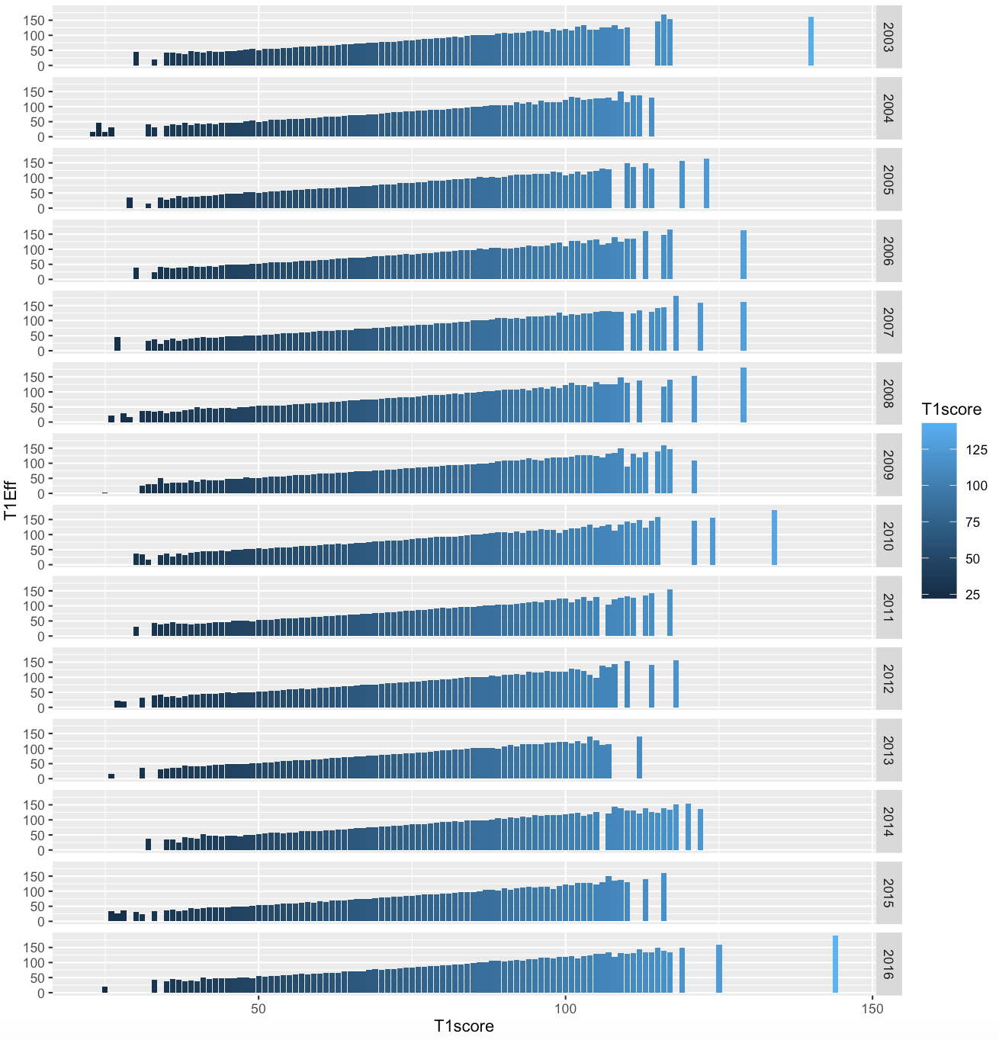

Slide 8
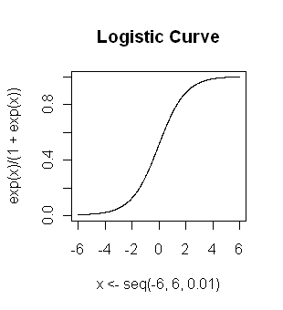
Logistic Regression
Logistic regression is a method for fitting a regression curve, y = f(x), when y consists of proportions or probabilities, or binary coded (0,1--failure, success) data.
When the response is a binary (dichotomous) variable, and x is numeric, logistic regression fits a logistic curve to the relationship between x and y.
The logistic function is: y = [exp(b₀ + b₁x)] / [1 + exp(b₀ + b₁x)]
b₀ and b₁= the regression coefficients

Slide 9
Logistic Regression
Feature Combination | Accuracy
T1score+T1Eff+T1poss+T1OE+T1DE+T1efg+T1top+T1torp+T1ftr+T2score+T2Eff+T2poss+T2OE+T2DE+T2efg+T2top+T2torp+T2ftr | 0.6716
T1Eff+T1poss+T1OE+T1DE+T1efg+T1top+T1torp+T1ftr+T2Eff+T2poss+T2OE+T2DE+T2efg+T2top+T2torp+T2ftr | 0.716418

Slide 10
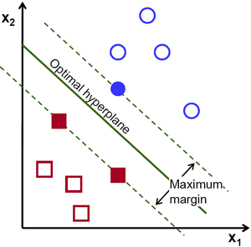
Support Vector Machine
A Support Vector Machine (SVM) is a discriminative classifier formally defined by a separating hyperplane
In other words, given labeled training data (supervised learning), the algorithm outputs an optimal hyperplane which categorizes new examples
The SVM algorithm is based on finding the hyperplane that gives the largest minimum distance to the training examples
The optimal separating hyperplane maximizes the margin of the training data
Two types of non-linear kernels are used for this project; La placian and Radial
Basis function

Slide 11
SVM (Laplacian)
Feature Combination | Accuracy
T1score+T1Eff+T1poss+T1OE+T1DE+T1efg+T1top+T1torp+T1ftr+T2score+T2Eff+T2poss+T2OE+T2DE+T2efg+T2top+T2torp+T2ftr | 0.6665
T1Eff+T1poss+T1OE+T1DE+T1efg+T1top+T1torp+T1ftr+T2Eff+T2poss+T2OE+T2DE+T2efg+T2top+T2torp+T2ftr | 0.6716

Slide 12
Decision Tree
Recursive partitioning is a fundamental tool in data mining
It helps us explore the structure of a set of data, while developing easy to visualize decision rules for predicting a categorical (classification tree) or continuous (regression tree) outcome
Tree methods such as CART (classification and regression trees) can be used as alternatives to logistic regression. It is a way that can be used to show the probability of being in any hierarchical group.
Boosted Trees are used for this classification problem

Slide 13
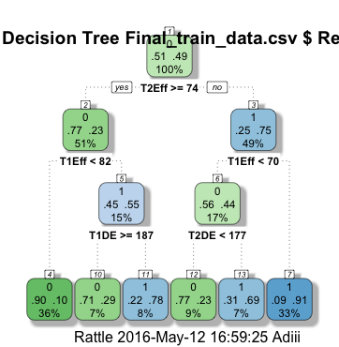
Decision Tree

Slide 14
Decision Trees
Feature Combination | Accuracy
T1score+T1Eff+T1poss+T1OE+T1DE+T1efg+T1top+T1torp+T1ftr+T2score+T2Eff+T2poss+T2OE+T2DE+T2efg+T2top+T2torp+T2ftr | 0.6417
T1Eff+T1poss+T1OE+T1DE+T1efg+T1top+T1torp+T1ftr+T2Eff+T2poss+T2OE+T2DE+T2efg+T2top+T2torp+T2ftr | 0.6567

Slide 15
Random Forest
A Random Forest classifier uses a number of decision trees, in order to improve the classification rate
It uses multiple models for better performance than just using a single tree model
In addition because many sample are selected in the process a measure of variable importance can be obtain and this approach can be used for model selection

Slide 16
Random Forest
Feature Combination | Accuracy
T1score+T1Eff+T1poss+T1OE+T1DE+T1efg+T1top+T1torp+T1ftr+T2score+T2Eff+T2poss+T2OE+T2DE+T2efg+T2top+T2torp+T2ftr | 0.6567
T1Eff+T1poss+T1OE+T1DE+T1efg+T1top+T1torp+T1ftr+T2Eff+T2poss+T2OE+T2DE+T2efg+T2top+T2torp+T2ftr | 0.6865

Slide 17
Neural Network
A neuron defines a relationship between the input signals received from dendrites and the output signal
Input signals are summed and passed to activation function f
Training means learning the values for the weights that will best approximate the output labels in our training set (x,y)
Original values for the weights are random

Slide 18
Neural Network
Feature Combination | Accuracy
T1score+T1Eff+T1poss+T1OE+T1DE+T1efg+T1top+T1torp+T1ftr+T2score+T2Eff+T2poss+T2OE+T2DE+T2efg+T2top+T2torp+T2ftr | 0.67167
T1Eff+T1poss+T1OE+T1DE+T1efg+T1top+T1torp+T1ftr+T2Eff+T2poss+T2OE+T2DE+T2efg+T2top+T2torp+T2ftr | 0.716418

Slide 19
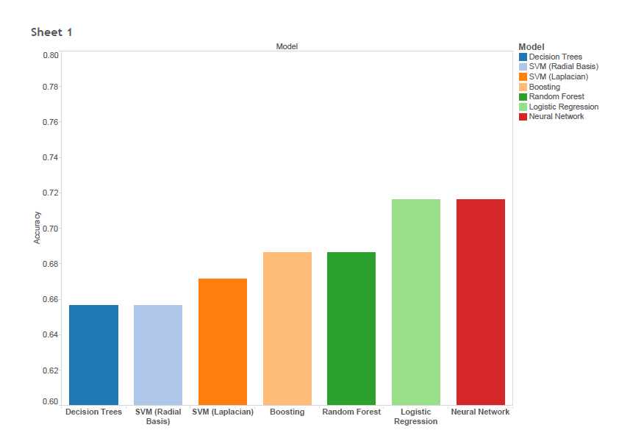
Results
Model | Correct | Accuracy
Neural Network | 48 | 0.716418
Logistic Regression | 48 | 0.716418
Boosting | 46 | 0.686567
Random Forest | 46 | 0.686567
SVM (Laplacian) | 45 | 0.671642
SVM (Radial Basis) | 44 | 0.656716
Decision Trees | 44 | 0.656716

Slide 20
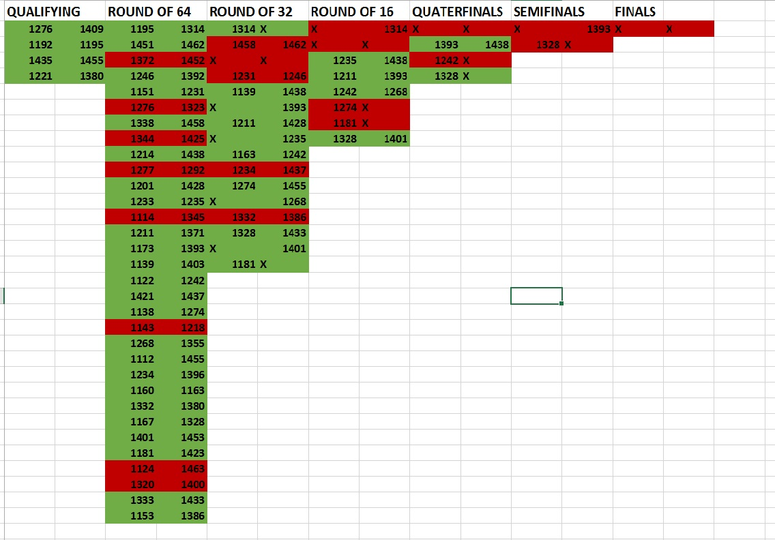
NCAA 2016 Tournament Bracket Prediction

Slide 21

Any Questions?

